Slide 1
SPACE INVADERS
Giammarco Boscaro

Slide 2
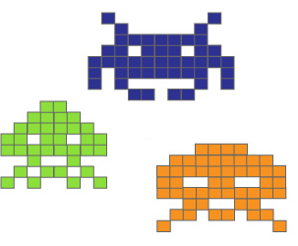
Introduction – The Project
A simple game
Revisited version of Space Invaders
Written in Java
Interfaced with Arduino
Uses a database to keep high scores

Slide 3
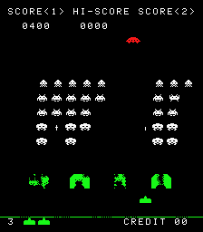
The Original
Famous arcade
Developed in 1978
Two dimensional fixed game
Runs on custom hardware

Slide 4
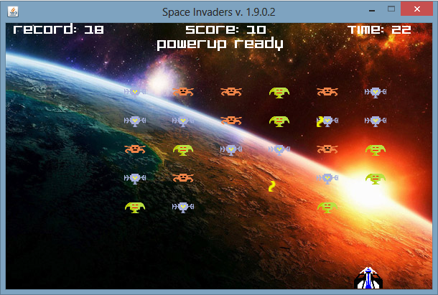
The Game
Actual application
Features:
Better graphic
Various menus
Different options
Scoreboard
Arduino’s support
Runs on the desktop

Slide 5

What’s Java
Created by Sun Microsystems on 1992
Compiled and Interpreted
Needs JVM
Object Oriented
Characteristics
Strongly Typed
Can run on web pages
Applets

Slide 6

What’s Arduino
Hardware
Open Source Framework
Simple programming language
Tons of libraries
Made in Italy
Software
Wiring
Supports most of the electronic devices

Slide 7

The Board
Reset button
Pin 13 led
Digital pins
USB Port
Microcontroller
Crystal oscillator
External power connector
Analog pins
Power and ground pins

Slide 8
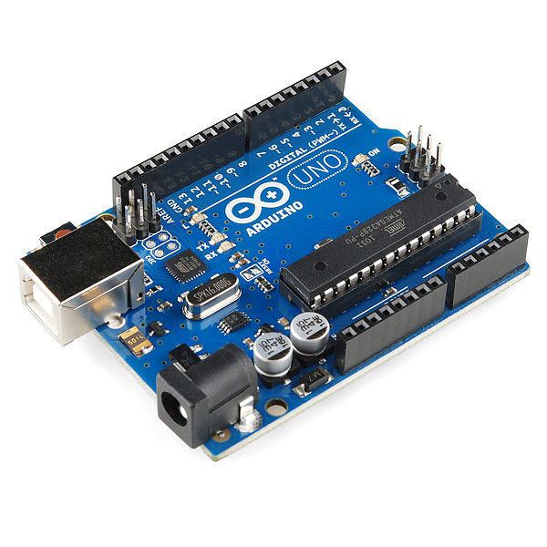
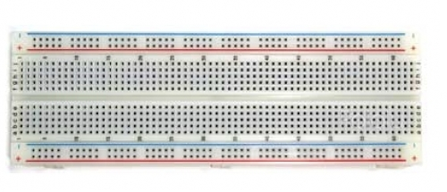
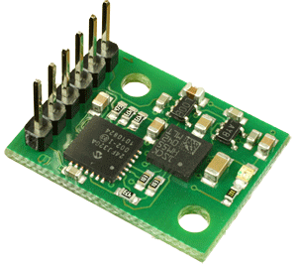
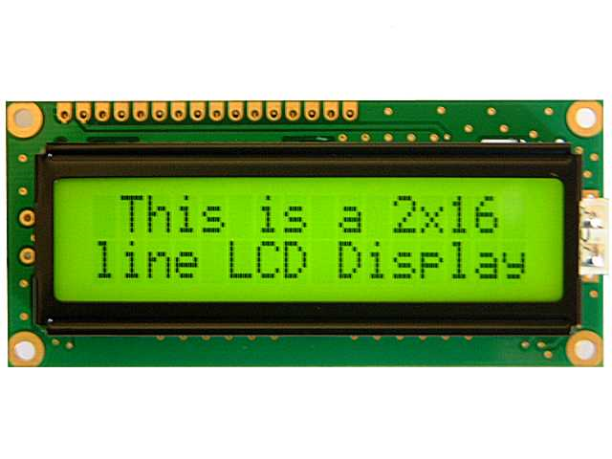
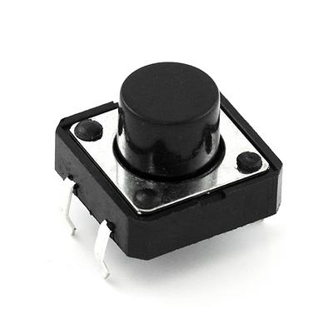
Materials
Breadboard
6 Axis Gyroscope
And then:
Resistors
USB Cable
Various breadboard cables
Arduino Uno
Button
LCD Display

Slide 9
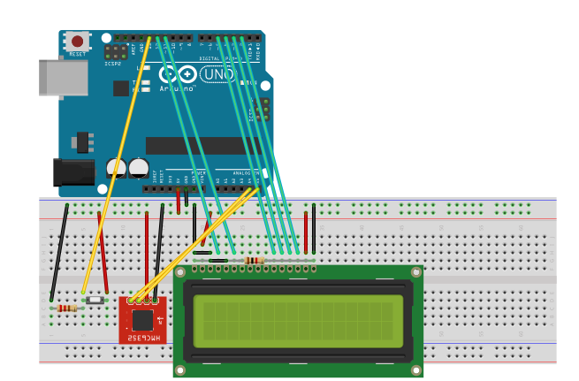
Circuit diagram
Button input - 13
GND
SCL – A5
+Vcc (5V)
SDA – A4
Data – 2 - 5

Slide 10




Programs & Utilities
And more:
Photoshop
Fritzing
RXTX Library
Eclipse IDE
JDK
Arduino DevKit
Microsoft Access

Slide 11
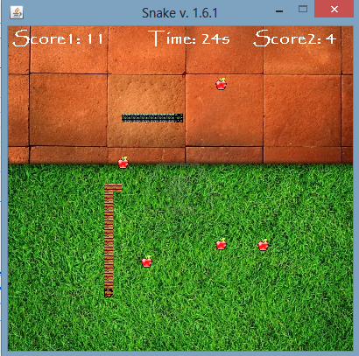
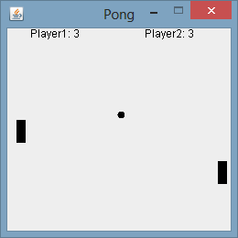
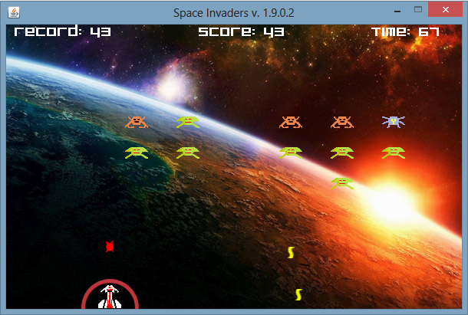
Realization
Java swing graphic
Pong
Just two classes
Arduino
Snake
Sprite graphic
Database
Space Invaders
Menus and options

Slide 12
How it works
Main class switches the various menus
Frame’s Created
Panels are initialized
Arduino’s thread is started
Game’s thread is started
Connection with the board. Starts polling.
Game’s loop is running
Process is killed

Slide 13
Problems
Main Problems
Interfacing Java with Arduino
Connection with the Database
NullPointerException while reading
32 and 64 bit software conflicts
Added another thread
Installed Access 64 bit and ODBC drivers

